Slide 1
Annotation: what it is and why you need to do it
I contend, quite bluntly, that marking up a book is not an act of mutilation, but of love.
Mortimer J. Adler
“How to Mark a Book”

Slide 2
Annotating is…
Annotate: (v) to supply with critical or explanatory notes; comment upon in notes
Basically…to write notes as you read either in the margins or on other paper
OR having a conversation with the text

Slide 3
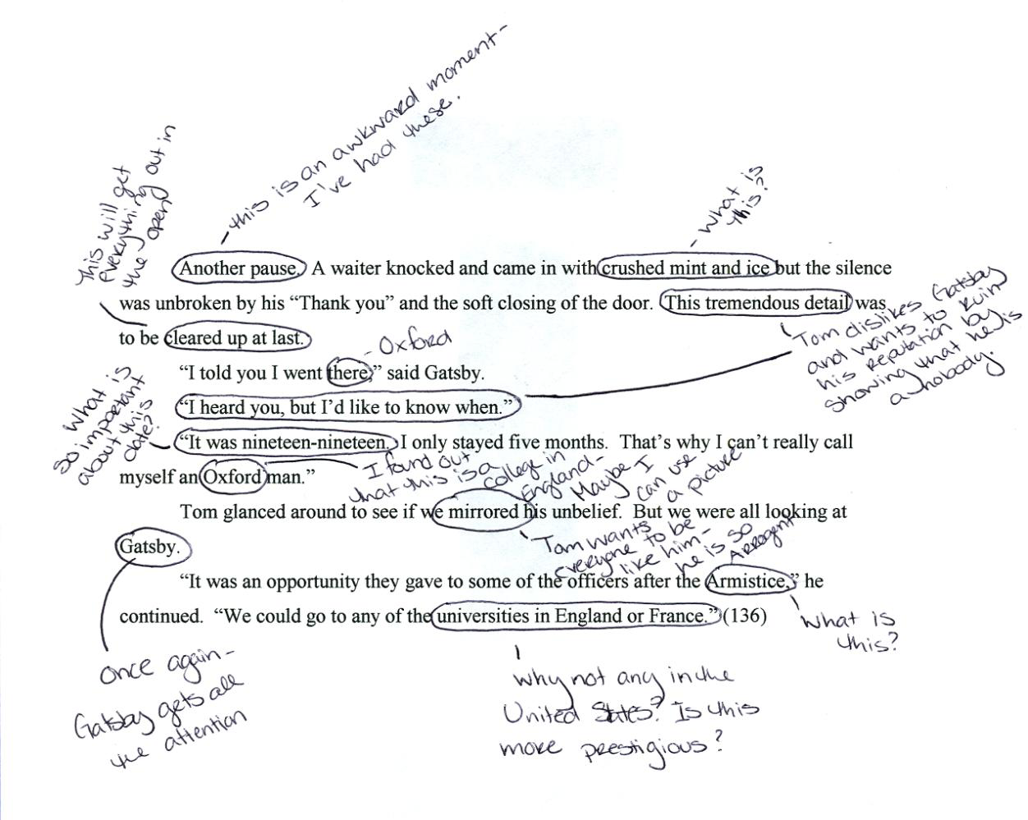

Slide 4
How do I know what to write?
As you work with your text, consider all of the ways that you can connect with what you are reading.
Can you think of something that happened in your life that relates?
Do you know about what is written or is it new to you?
What things are confusing or make sense to you?
Is it an “aha” moment?

Slide 5
Suggestions for annotating

Slide 6
Define Words
Define words or slang; make the words real with examples from your experiences; explore why the author would have used a particular word or phrase.
If the word is unfamiliar to you LOOK IT UP!
Circling the word is one way to acknowledge you don’t know it.
You could also make a list in the back of the book of all the words you do not know.
You can’t just stop there though…you must LOOK IT UP!

Slide 7
Make connections to other parts of the book. Feel free to use direct quotes from the book.

Slide 8
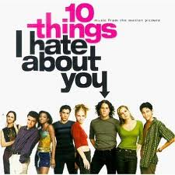
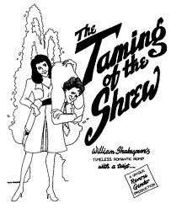
Make connections to other texts you have read or seen, including:
Movies
Comic books/graphic novels
News events
Other books, stories, plays, songs, or poems

Slide 9
Draw a picture when a visual connection is appropriate.
He was a big, beefy man with hardly any neck, although he did have a very large mustache. Mrs. Dursley was thin and blonde and had nearly twice the usual amount of neck, which came in very useful as she spent so much of her time craning over garden fences, spying on the neighbors(p1).
Harry Potter and the Sorcerer’s Stone

Slide 10
Paraphrase
Re-write, paraphrase, or summarize a particularly difficult passage or moment.
Rewrite the thesis in your own words in the margins
Highlight key passages

Slide 11
Make meaningful connections to your own life experiences.
The sisters in this play/movie reminds me of the relationship between me and my sister

Slide 12
Describe a new perspective you may now have.
AHA moment—moment where something becomes clear, or where you change your mind about something

Slide 13
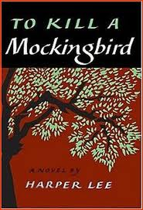
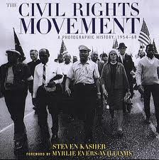
Explain the historical context or traditions/social customs that are used in the passage.

Slide 14
Offer an analysis or interpretation of what is happening in the text.
The main character is doing this because…

Slide 15
Point out and discuss literary techniques that the author is using.
Those literary terms you always learn…point them out
Metaphor
Symbol
Alliteration
Personification
Theme
Mood
etc

Slide 16
Different ways to annotate
2-column method
Post-it method
Footnotes
Writing directly on the piece (margins or text)
Simply taking notes in a notebook as you read

Slide 17
Important things to remember
Page number, page number, page number!
When it is your own book don’t be afraid to write in it.
Start annotating all books you are reading—even if it’s just for fun.
Always read with a pencil in your hand!
When reading things online-print a copy of valuable information—or keep a notebook by your computer.

Slide 18
Annotation Checklist
_____I circled unknown words and wrote the definitions.
_____I wrote the gist in the margins. The gist is a two- to three- word phrase that sums up a paragraph or group of paragraphs. (summary)
_____I wrote my opinions and questions in the margins. These comments/questions are thoughtful and not random or irrelevant.
_____I wrote the author’s main idea at the end of the article. This is one sentence long and states the author’s point.

Slide 19
Ok. Annotate. But why?
Annotating will:
deepen your understanding of a text
allow easy access for notes when writing research
help you as writers understand how the audience may perceive your work
Basically, the conversation you create will make you a better reader and writer.

